Slide 1
R markdown and Shiny
“Processing large dataset with R”

Slide 2
R markdown
Rmarkdown is a comprehensive way of creating reports which involve R.
R markdown is a format for literate programming documents. It is based on markdown, a markup language that is widely used to generate html pages.
Literate programming weaves instructions, documentation and detailed comments in between machine executable code, producing a document that describes the program.
Unlike a word processor, such as Microsoft Word, where what you see is what you get, with R markdown, you need to compile the document into the final report.

Slide 3

How it works
When you run render, R Markdown feeds the .Rmd file to knitr, which executes all of the code chunks and creates a new markdown (.md) document which includes the code and it’s output.
The markdown file generated by knitr is then processed by pandoc ⧉ which is responsible for creating the finished format.
This may sound complicated, but R Markdown makes it extremely simple by encapsulating all of the above processing into a single render function.

Slide 4
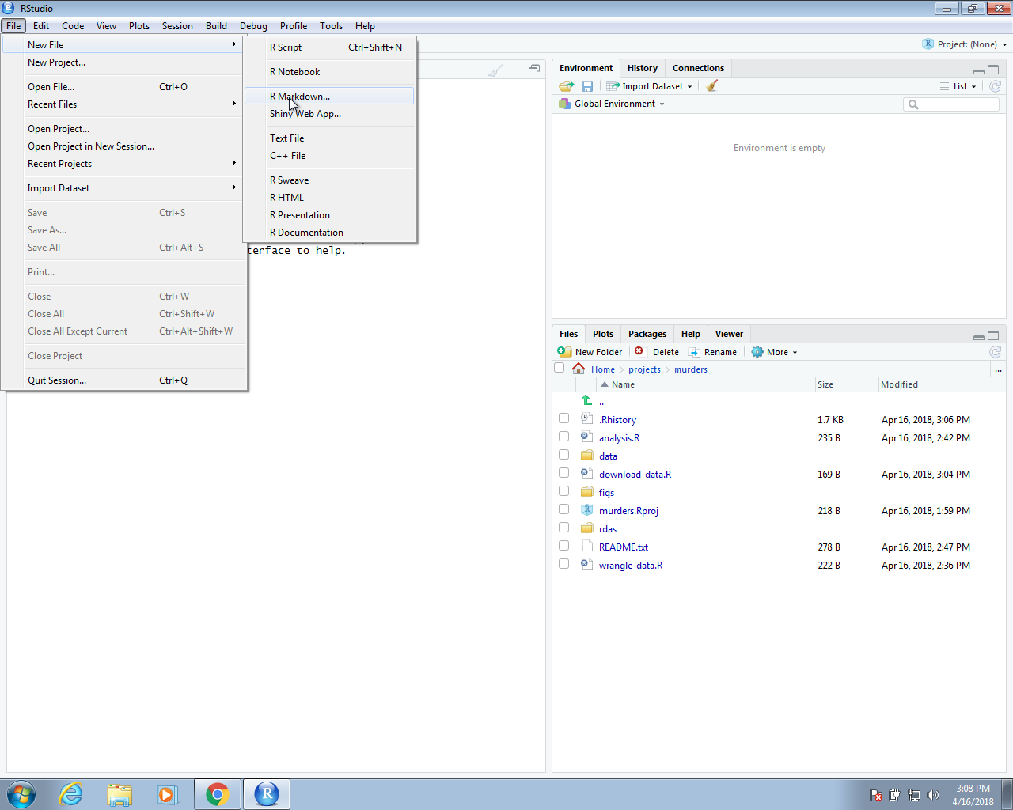
Let’s start
In RStudio, you can start an R markdown document by clicking on File, New File, the R Markdown, like this:

Slide 5
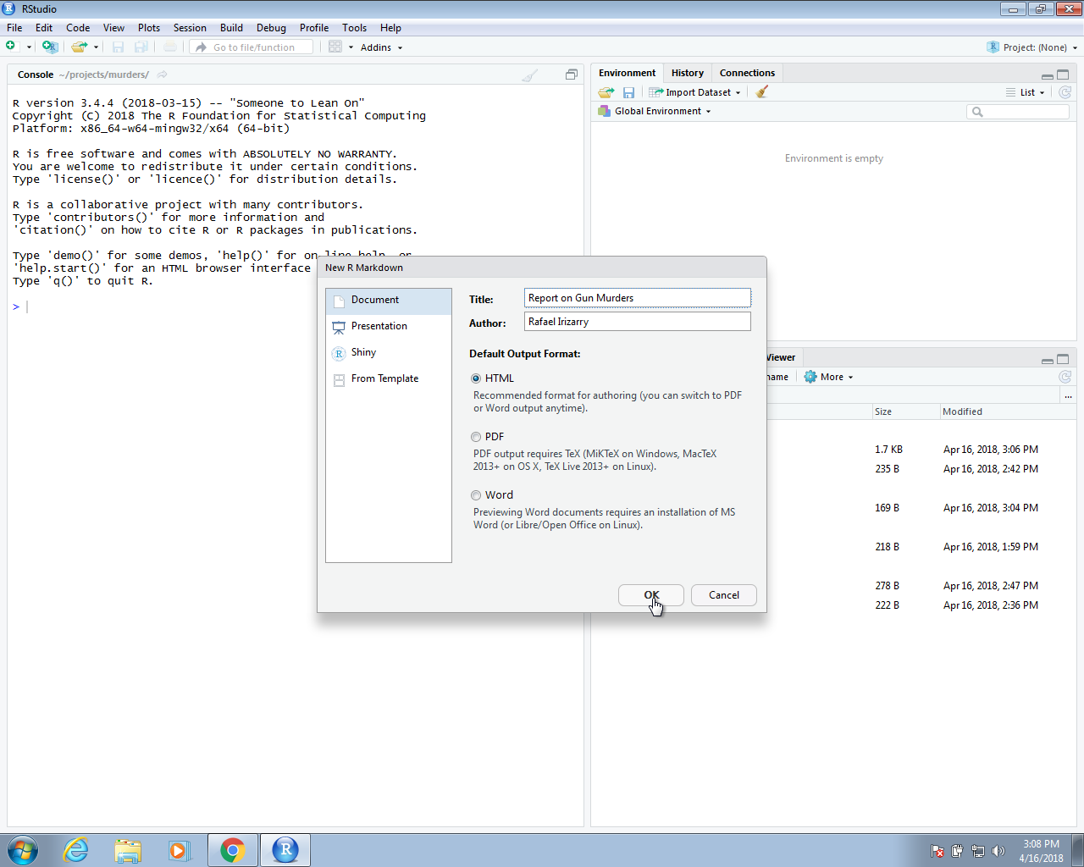
Project initialization
You will then be asked to enter a title and author for your document. We are going to prepare a report on gun murders so we will give it an appropriate name. You can also decide what format you would like the final report to be in: HTML, PDF, or Microsoft Word.
Later, we can easily change this, but here we select html as it is the preferred format for debugging purposes:

Slide 6
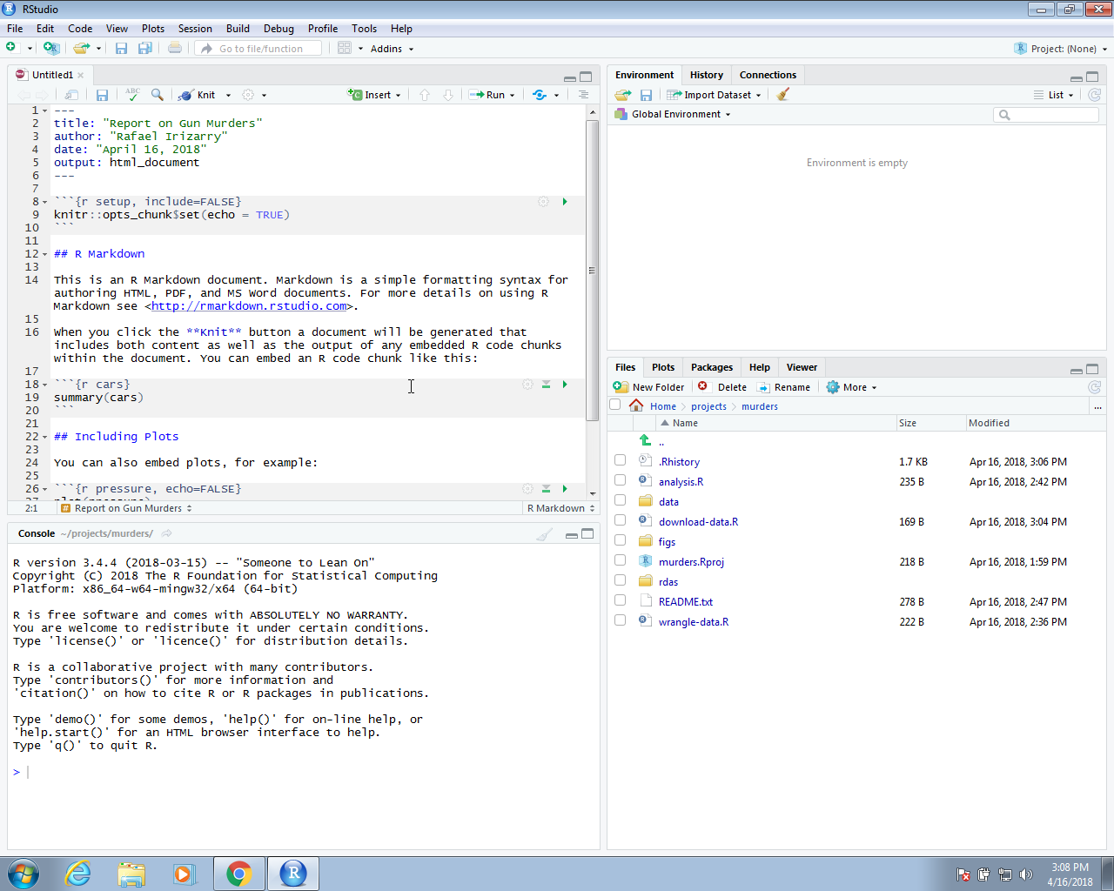
Project initialization
This will generate a template file:

Slide 7
The header
At the top you see:
---
title: "Report on Gun Murders"
author: "Rafael Irizarry"
date: "April 16, 2018"
output: html_document
---
The things between the --- is the header. We actually don’t need a header, but it is often useful. You can define many other things in the header than what is included in the template.
The one parameter that we will highlight is output. By changing this to, say, pdf_document, we can control the type of output that is produced when we compile.

Slide 8
R code chunks
In various places in the document, we see something like this:
```{r}
summary(pressure)
```
These are the code chunks. When you compile the document, the R code inside the chunk, in this case summary(pressure), will be evaluated and the result included in that position in the final document.
To add your own R chunks, you can type the characters above quickly with the key binding command-option-I on the Mac and Ctrl-Alt-I on Windows.
We recommend getting into the habit of adding a label to the R code chunks. This will be very useful when debugging, among other situations. You do this by adding a descriptive word like this:
```{r – summary pressure}
summary(pressure)
```

Slide 9
Chunk Options
include = FALSE prevents code and results from appearing in the finished file. R Markdown still runs the code in the chunk, and the results can be used by other chunks.
echo = FALSE prevents code, but not the results from appearing in the finished file. This is a useful way to embed figures.
the eval option disables the execution of the code.
message = FALSE prevents messages that are generated by code from appearing in the finished file.
warning = FALSE prevents warnings that are generated by code from appearing in the finished.
fig.cap = "..." adds a caption to graphical results.
See the R Markdown Reference Guide ⧉ for a complete list of knitr chunk options

Slide 10
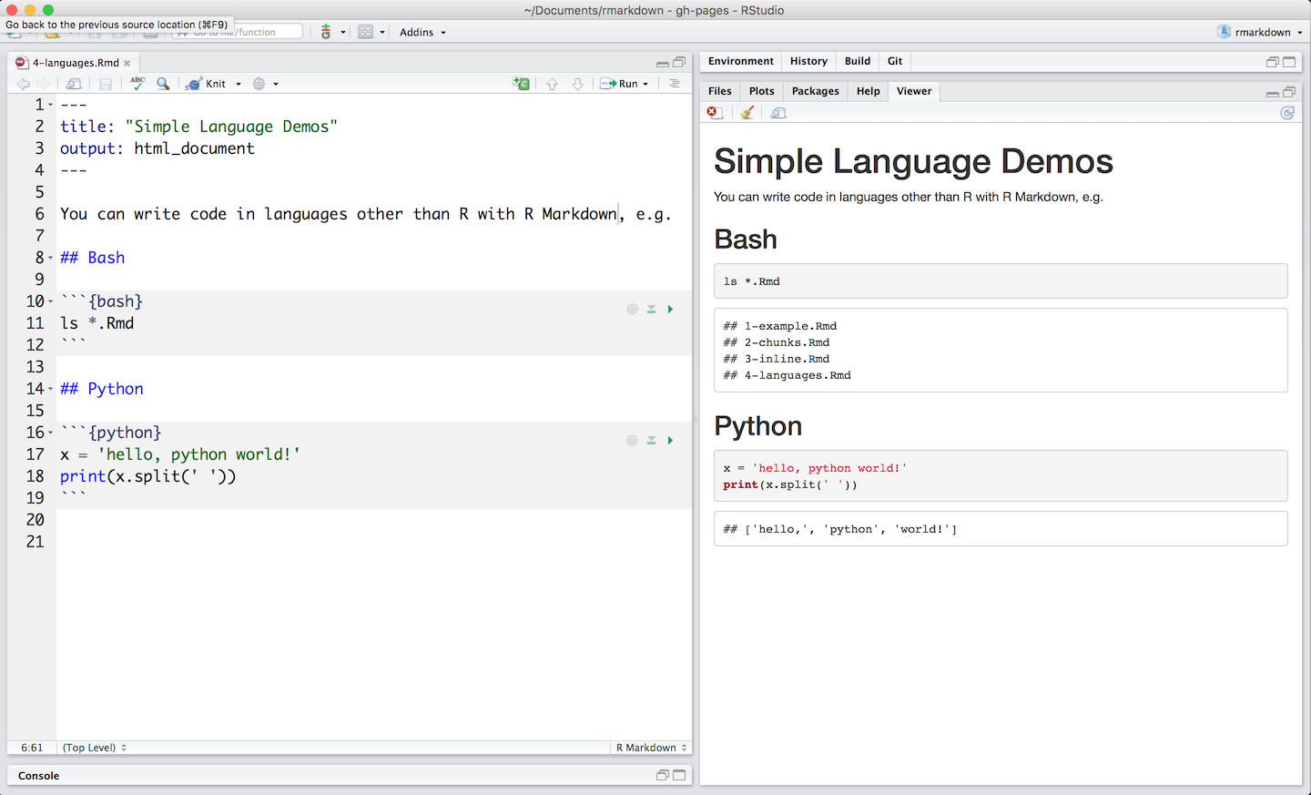
Code Languages
.Rmd file executes code in bash and python.
Python
SQL
Bash
Rcpp
Stan
JavaScript
CSS

Slide 11
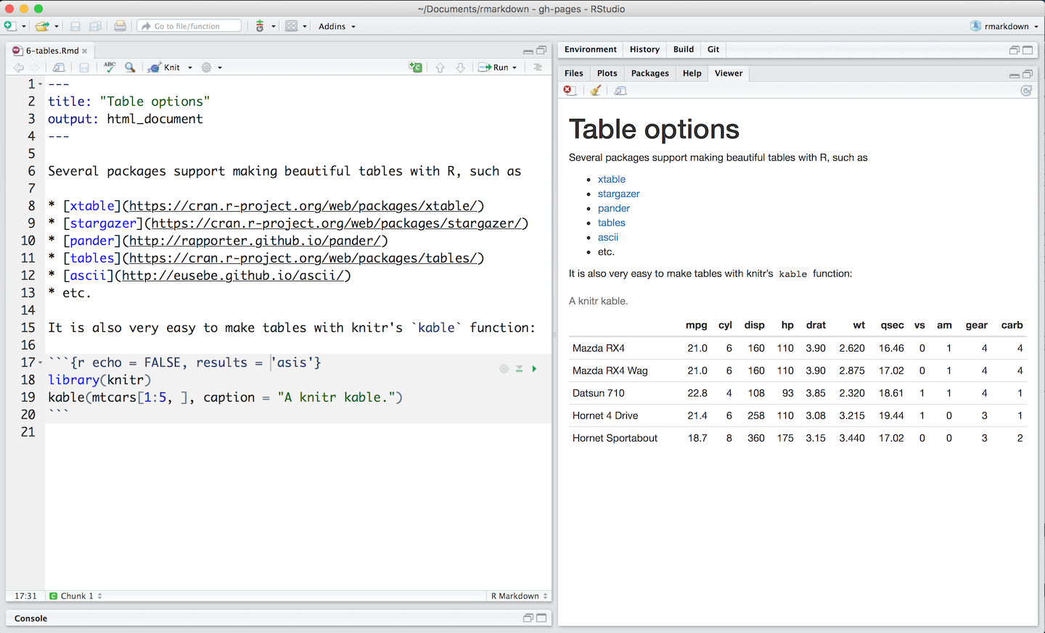
Tables
By default, R Markdown displays data frames and matrixes as they would be in the R terminal (in a monospaced font). If you prefer that data be displayed with additional formatting you can use the knitr::kable function

Slide 12
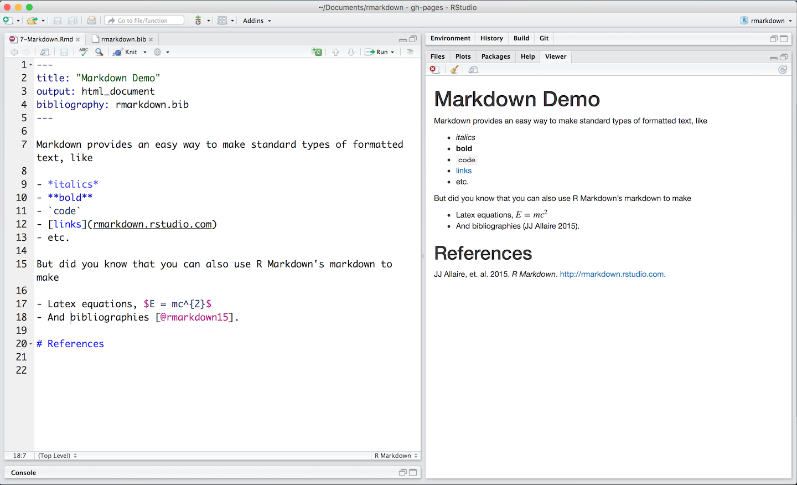
Markdown Basics
Format the text in your R Markdown file with Pandoc’s Markdown, a set of markup annotations for plain text files. When you render your file, Pandoc transforms the marked up text into formatted text in your final file format
Headers
Lists
Links
Images
Block quotes
Latex equations
Horizontal rules
Tables
Footnotes
Bibliographies and Citations
Slide breaks
Italicized text
Bold text
Superscripts
Subscripts
Strikethrough text

Slide 13
Markdown Basics
the # allows to organize the document in sections, subsections, … The more you add #, the more you go down into the subsections, subsubsections, …
the * allows to higlight some part of the text: if you use one *tyty* it produces tyty. If you use **tyty**, the text tyty will be in bold.
the > allows to create some “citation / remark box”: > The citation that I would like to highlight!
It is possible to provide online code using single quote. As an exemple: ls().

Slide 14
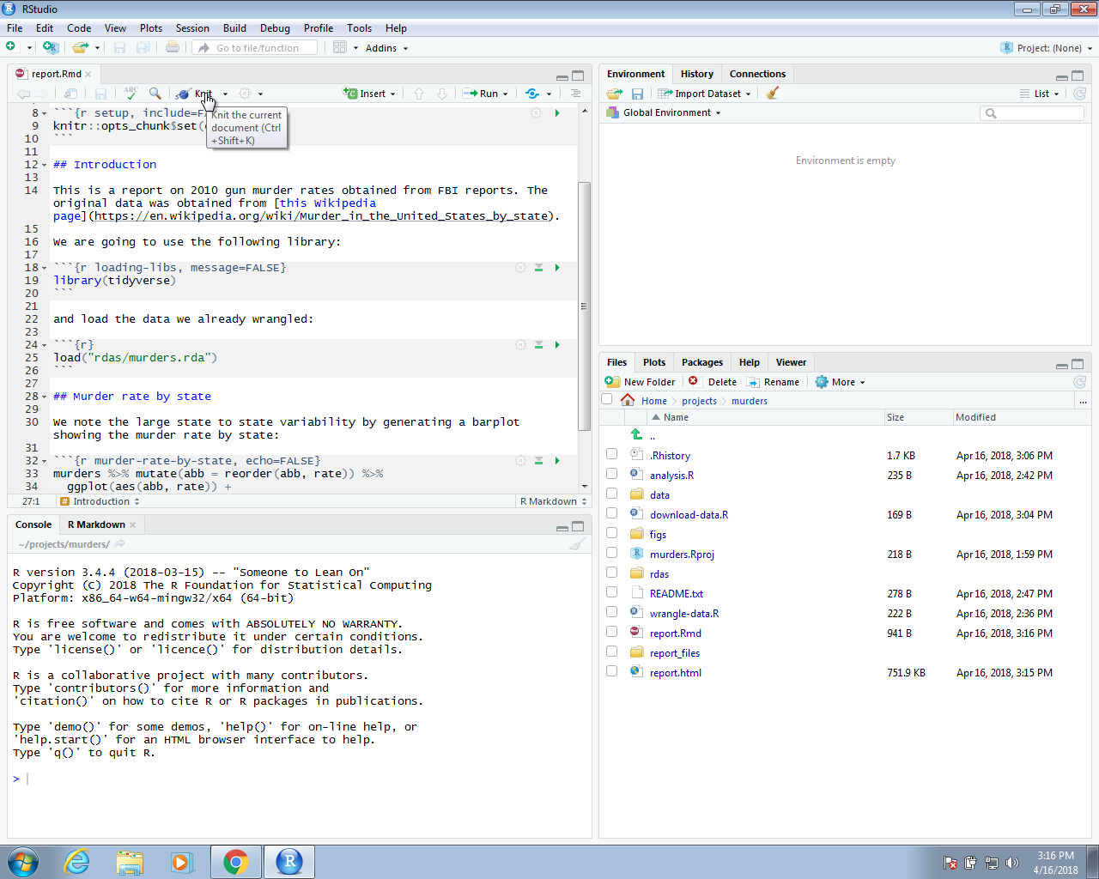
knitR
We use the knitR package to compile R markdown documents. The specific function used to compile is the knit function, which takes a filename as input. RStudio provides a button that makes it easier to compile the document.

Slide 15
Example
--- title: "Report on Gun Murders"
author: "Rafael Irizarry"
date: "`r format(Sys.Date())`"
output: github_document
---
```{r setup, include=FALSE}
knitr::opts_chunk$set(echo = TRUE)
```
## Introduction
This is a report on 2010 gun murder rates obtained from FBI reports. The original data was obtained from [this Wikipedia page](https://en.wikipedia.org/wiki/Murder_in_the_United_States_by_state). We are going to use the following library:
```{r loading-libs, message=FALSE}
library(tidyverse)
```
and load the data we already wrangled:
```{r} load("rdas/murders.rda")
```
## Murder rate by state
We note the large state to state variability by generating a barplot showing the murder rate by state:
```{r murder-rate-by-state, echo=FALSE}
murders %>% mutate(abb = reorder(abb, rate)) %>%
ggplot(aes(abb, rate)) + geom_bar(width = 0.5, stat = "identity", color = "black") + coord_flip()
```

Slide 16
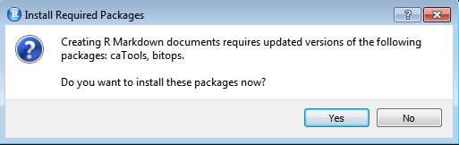
Knit button
The first time you click on the Knit button, a dialog box may appear asking you to install packages you need:
Once you have installed the packages, clicking the Knit will compile your R markdown file and the resulting document will pop-up:
This produces an html document which you can see in your working directory. To view it, open a terminal and list the files. You can open the file in a browser and use this to present your analysis. You can also produce a PDF or Microsoft document by changing:
output: html_document to output: pdf_document or output: word_document.

Slide 17
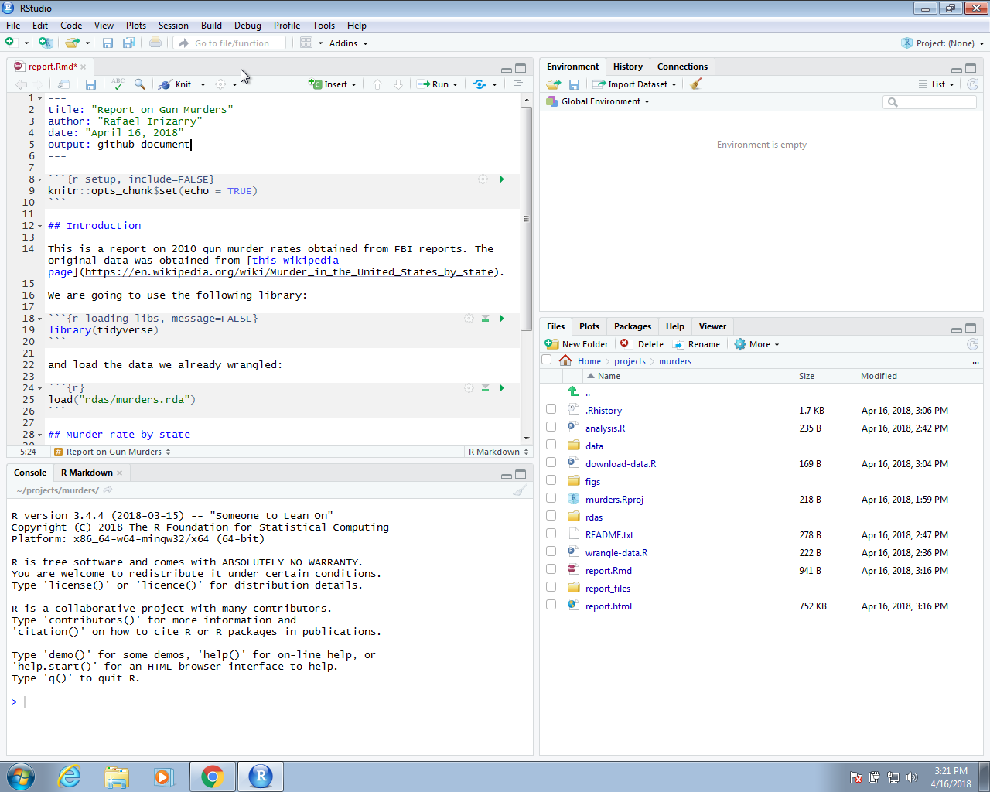
github_document
We can also produce documents that render on GitHub using output: github_document like this:

Slide 18
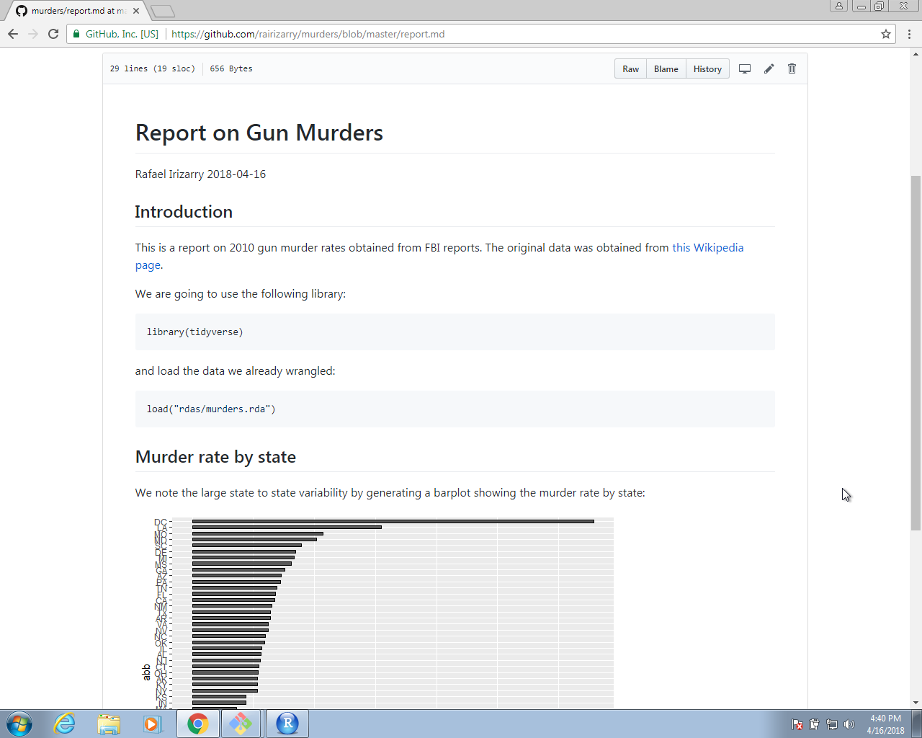
Web report
This will produce a markdown file, with suffix md, that renders in GitHub. Because we have uploaded these files to GitHub, you can click on the md file and you will see the report as a webpage:

Slide 19
Slide presentation
R Markdown renders to four presentation formats:
beamer_presentation - PDF presentations with beamer
ioslides_presentation - HTML presentations with ioslides
slidy_presentation - HTML presentations with slidy
powerpoint_presentation - PowerPoint presentation
revealjs::revealjs_presentation - HTML presentations with reveal.js
Each format will intuitively divide your content into slides, with a new slide beginning at each first or second level header.

Slide 20
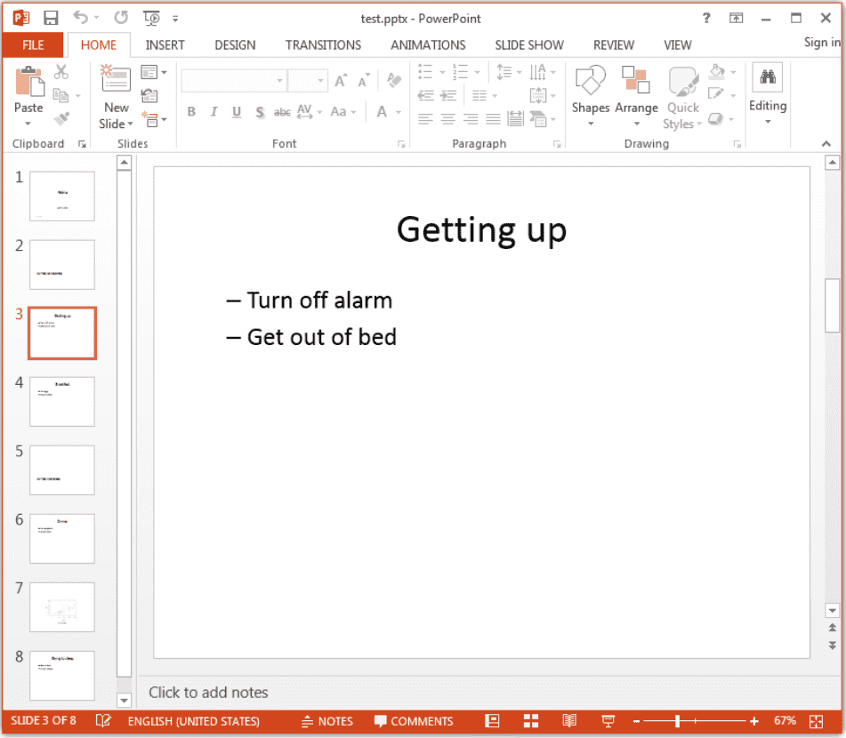
Power Point
--- title: "Habits"
author: John Doe
date: March 22, 2005
output: powerpoint_presentation
---
# In the morning
## Getting up
Turn off alarm
Get out of bed
## Breakfast
Eat eggs
Drink coffee
# In the evening
## Dinner
Eat spaghetti
Drink wine
---
```{r, cars, fig.cap="A scatterplot.", echo=FALSE}
plot(cars)
```
## Going to sleep
Get in bed
Count sheep

Slide 21
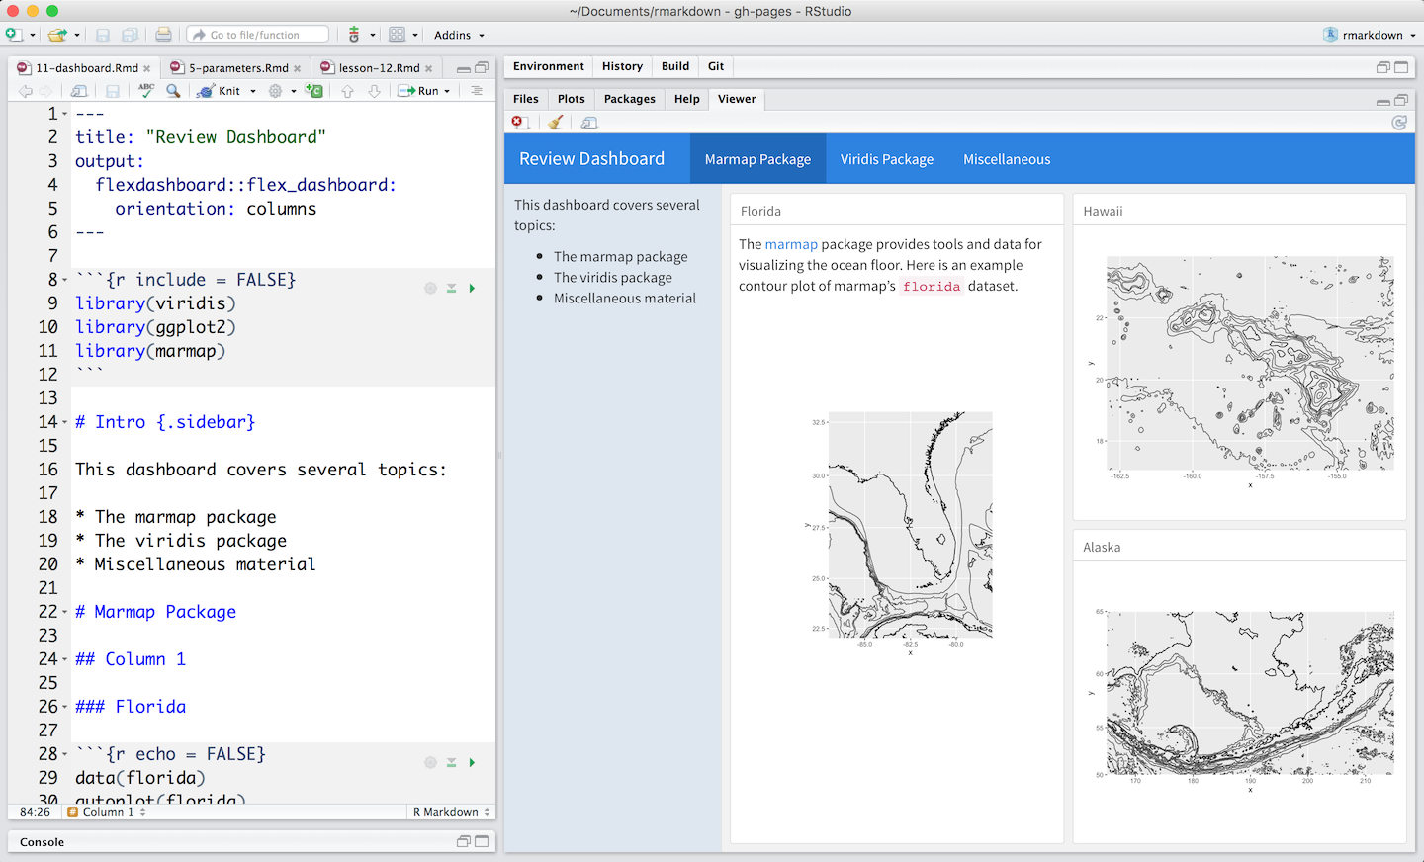
Dashboard
Dashboards are a useful way to communicate large amounts of information visually and quickly. Create one with the flexdashboard::flex_dashboard output format
Flexdashboard makes it easy to organize your content into a visual layout:
Each Level 1 Header (#) begins a new page in the dashboard.
Each Level 2 Header (##) begins a new column.
Each Level 3 Header (###) begins a new box.

Slide 22
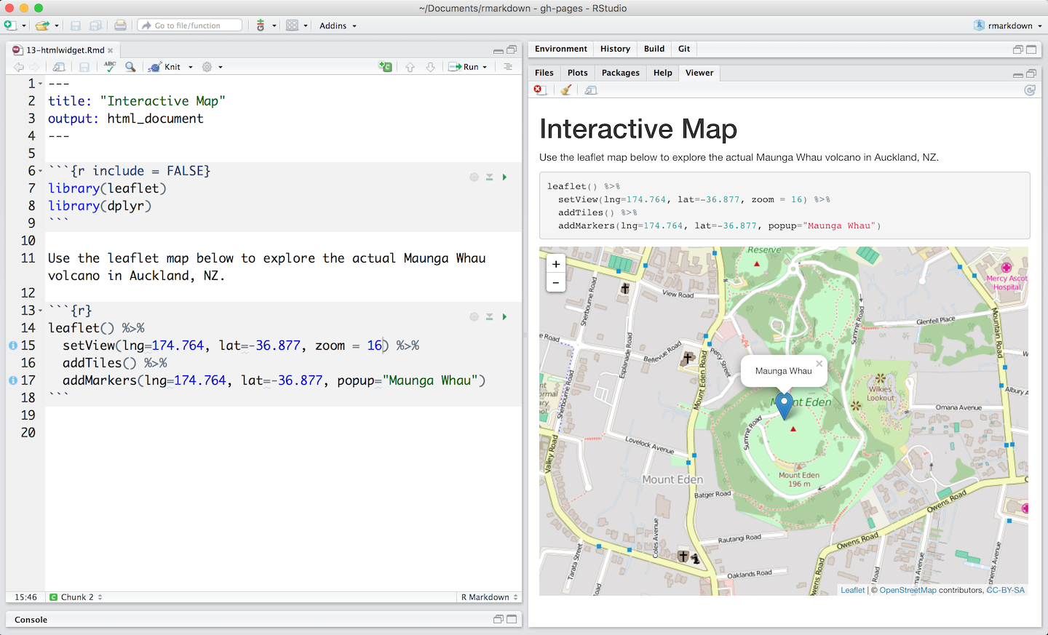
Interactive documents
Markdown documents are a perfect platform for interactive content. To make your documents interactive, add:
Interactive JavaScript visualizations based on htmlwidgets or
Reactive components made with Shiny

Slide 23
Shiny
Shiny is an R package that makes it easy to build interactive web apps straight from R.
You can host standalone apps on a webpage or embed them in R Markdown documents or build dashboards.
You can also extend your Shiny apps with CSS themes, htmlwidgets, and JavaScript actions.
web apps was for R users:
In the past
With shiny
You need a deep knowledge of web technologies like HTML, CSS and JavaScript.
Making complex interactive apps requires careful analysis of interaction flows to make sure that when an input changes, only the related outputs are updated.
Providing a carefully curated set of user interface (UI for short) functions that generate the HTML, CSS, and JavaScript that you need for common tasks.
Introducing a new style of programming called reactive programming which automatically tracks the dependencies of a code chunk.
Notes:
This means that you don’t know need to know the details of HTML/CSS/JS until you want to go beyond the basics that Shiny provides for you.
This means that whenever an input changes, Shiny can automatically figure out how to do the smallest amount of work to update all the related outputs.

Slide 24
Every Shiny app is maintained by a computer running R

Slide 25
Introduction
Two key components of every Shiny app:
the UI (short for user interface) which defines how your app looks,
the server function which defines how you app works. Shiny uses reactive programming to automatically update outputs when inputs change so we’ll finish off the chapter by learning the third important component of Shiny apps: reactive expressions.
install.packages("shiny")
library(shiny)

Slide 26
Build your app

Slide 27
Inputs

Slide 28
Inputs

Slide 29
Syntax

Slide 30
Other inputs

Slide 31
Outputs

Slide 32
Outputs

Slide 33
Outputs

Slide 34
how to assemble inputs into outputs ?

Slide 35
Server function

Slide 36
Render

Slide 37
Two inputs

Slide 38
Two outputs

Slide 39
Reactivity

Slide 40
Two outputs with reactive()

Slide 41
Can we prevent the title field from updating the plot?

Slide 42
Can we prevent the title field from updating the plot?

Slide 43
Action buttons

Slide 45
Action buttons

Slide 48
Summary

Slide 49
Exercises
Create a slider input to select values between 0 and 100 where the interval between each selectable value on the slider is 5. Then, add animation to the input widget so when the user presses play the input widget scrolls through automatically.
Create an app that compare 2 two simulated datasets with a plot and a hypothesis test (tips. Histogram and ttest)
Redo the previous exercise using reactivity

Slide 50
UI
ui <- fluidPage(
fluidRow(
column(4,
"Distribution 1",
numericInput("n1", label = "n", value = 1000, min = 1),
numericInput("mean1", label = "µ", value = 0, step = 0.1),
numericInput("sd1", label = "σ", value = 0.5, min = 0.1, step = 0.1)
),
column(4,
"Distribution 2",
numericInput("n2", label = "n", value = 1000, min = 1),
numericInput("mean2", label = "µ", value = 0, step = 0.1),
numericInput("sd2", label = "σ", value = 0.5, min = 0.1, step = 0.1)
),
column(4,
"Histogram",
numericInput("binwidth", label = "Bin width", value = 0.1, step = 0.1),
sliderInput("range", label = "range", value = c(-3, 3), min = -5, max = 5)
)
),
fluidRow(
column(9, plotOutput("hist")),
column(3, verbatimTextOutput("ttest"))
)
)

Slide 51
server
server <- function(input, output, session) {
output$hist <- renderPlot({
x1 <- rnorm(input$n1, input$mean1, input$sd1)
x2 <- rnorm(input$n2, input$mean2, input$sd2)
histogram(x1, x2, binwidth = input$binwidth, xlim = input$range)
})
output$ttest <- renderText({
x1 <- rnorm(input$n1, input$mean1, input$sd1)
x2 <- rnorm(input$n2, input$mean2, input$sd2)
t_test(x1, x2)
})
}

Slide 52
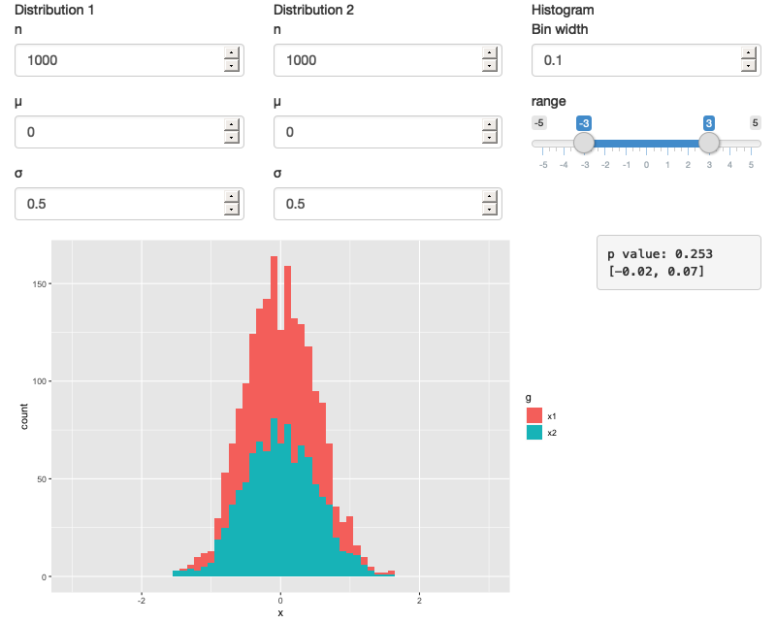
app

Slide 53
After reactivity
ui <- fluidPage(
fluidRow(
column(3,
numericInput("lambda1", label = "lambda1", value = 3),
numericInput("lambda2", label = "lambda2", value = 3),
numericInput("n", label = "n", value = 1e4, min = 0)
),
column(9, plotOutput("hist"))
)
)
server <- function(input, output, session) {
x1 <- reactive(rpois(input$n, input$lambda1))
x2 <- reactive(rpois(input$n, input$lambda2))
output$hist <- renderPlot({
histogram(x1(), x2(), binwidth = 1, xlim = c(0, 40))
})
}

Slide 54
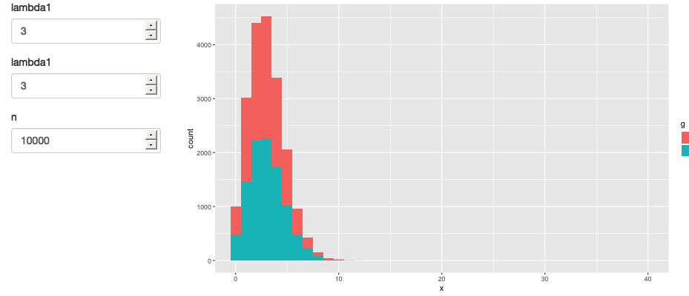
app

